Slide 1
GP Taxi Model
ABC Cabs: Getting NYC moving again

Slide 2
Executive Summary
52% of Taxi on-road time spent without customer
Accurate modeling of demand drives occupancy
In-cab demand forecasting and smart routing drive revenue
Predicting destination is more important than pickup location

Slide 3
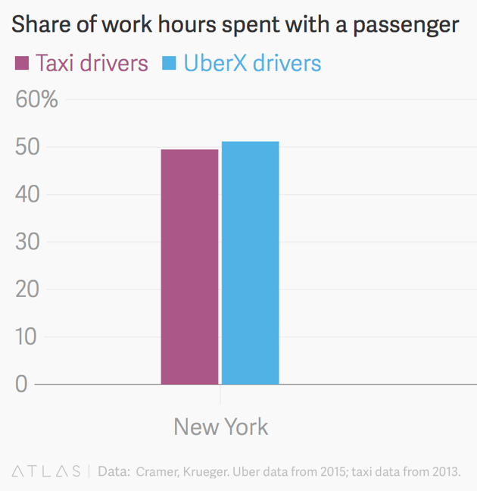
Downtime
Taxis in NYC are only 48% utilized¹
13,587 Taxis in NYC²
7,065 of them are wasted (equivalent)
ABC has 33% market share (4,400 cabs)
What could we achieve with 52% (2,300)
more?

Slide 4
Our Proprietary GP System
Real time forecasts of fares and demand
Ensemble:
Time-binned Gaussian Processes model (demand)
Random Forest Regressor (revenue)

Slide 5
Demand
A total picture of demand
Taxis in the right place, beat the competition
Identifies best, closest locations for taxi hailing
Focuses on lucrative and otherwise under-served areas

Slide 6
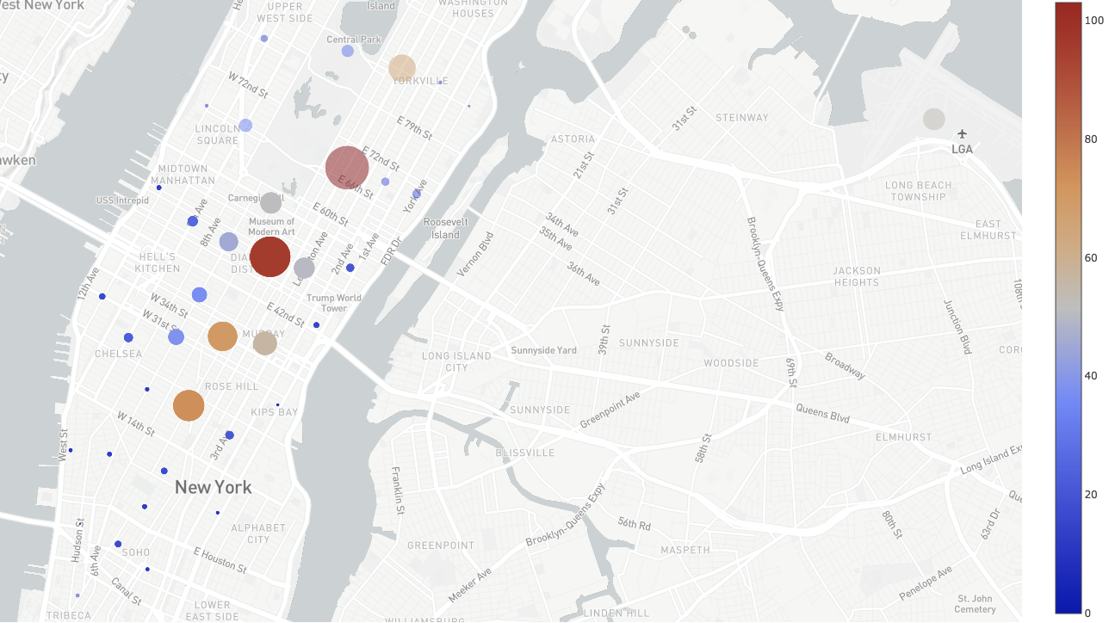
15 minute forecasts of neighbourhood demand
In-car driver-facing UI
Encourages higher occupancy
Based on time of day & day
of week seasonality

Slide 7
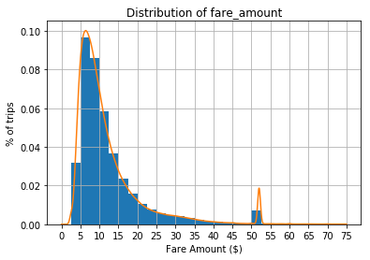
Revenue
50th percentile for fares is $9.50
But, the most profitable trips (per second) are the shortest!
Sweet spot is less than 8 minutes
Don’t fight this, embrace it
More, shorter, trips

Slide 8
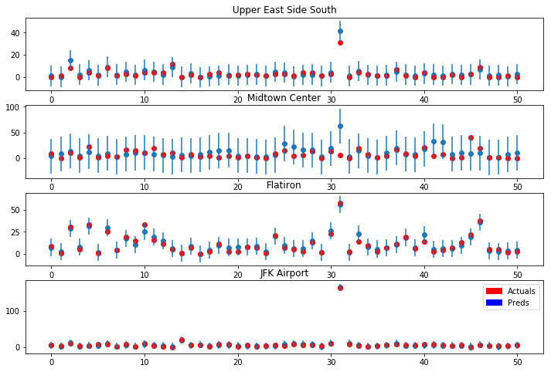
Second Order Demand
Where do the customers in each neighbourhood want to go?
Time-binned second-order demand forecast
Smart routing to keep taxis within high-demand neighbourhoods
Bayesian model gives confidence; smaller bars mean more certainty

Slide 9
Drive Satisfaction
Customers have ABC cab their door before they know they want one
Drivers are in the right place
Better tips
More revenue
Create more value than the competition

Slide 10
Projections
Taxis make on average $400 a day revenue
72% utilization (a 50% improvement across 4,400 cabs)
$880,000 a day
$88,000/day for the corporation

Slide 12
Next Steps
Deploy model into production systems (1 month)
Build out driver-facing UI (3 months)
Integrate with dispatch system (2 months)
Train cab drivers in effective use of model (1-2 days)
Future enhancements:
Outlier detection for fraudulent driver identification
Fare dispute/non-payment customer risk ratings

